Slide 1


Slide 2
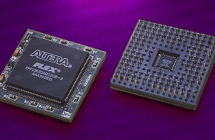
Definition
An integrated circuit (IC), sometimes called a chip or microchip, is a semiconductor wafer on which thousands or millions of tiny resistors, capacitors, and transistors are fabricated.
An IC can function as an amplifier, oscillator, timer, counter, computer memory, or microprocessor.

Slide 3
Classification of IC
A particular IC is categorized
Linear (analog) IC
Digital IC

Slide 4
Linear or Analog IC
The output signal level is a linear function of the input signal level. Ideally, when the instantaneous output is graphed against the instantaneous input, the plot appears as a straight line.
Linear ICs are used as audio-frequency (AF) (few Hz) and radio-frequency (RF)(KHz) amplifiers. The operational amplifier(op amp) is a common device in these applications.
Example: 555 Timer IC, µA741 op-amp, LM78XX (Voltage Regulator) etc.

Slide 5
Digital IC
Digital ICs operate at only a few defined levels or states.
These devices are used in computers, computer networks, modems, and frequency counters.
The fundamental building blocks of digital ICs are logic gates, which work with binary data, that is, signals that have only two different states, called low (logic 0) and high (logic 1).
Example 7408, 7486, 74266 etc

Slide 6
Advantages of IC
Several factors have made the integrated circuit popular:
They are reliable with complex circuits(internal components are interconnected)
  They have low power consumption (<1 watt)
  (5 to 15 v even less than1.3 v ,in mA)
  Small size and weight
  Economical to produce(at same time, mass production)
  New and better solutions to system problems
•

Slide 7
Advantages of IC
SMALL SIZE
LOW COST
IMPROVED PERFORMANCE
HIGH RELIABILITY AND RUGGEDNESS
LOW POWER CONSUMPTION
LESS VULNERABILITY TO PARAMETER VARIATION(any transistor or voltage variation)
EASY TROUBLESHOOTING
INCREASED OPERATING SPEED
LESS WEIGHT,VOLUME
EASY REPLACEMENT

Slide 8
Disadvantages of IC
They cannot handle large amounts of current or voltage.
High current generates excessive heat, damaging the device.
High voltage breaks down the insulation between the various internal components.
Integrated circuits cannot be repaired.
This is because the internal components cannot be separated.
Therefore, problems are identified by individual circuit instead of by individual component.
The advantage of this disadvantage is that it greatly simplifies maintaining highly complex systems.
It also reduces the amount of time required for maintenance personnel to service equipment.
ADVANTAGES OVERWEIGH DISADVANTAGES
AT PRESENT COILS, INDUCTORS AND TRANSFORMERS CAN NOT BE PRODUCED IN IC FORM.

Slide 9
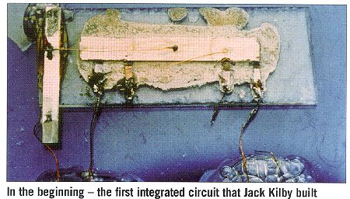
Introduction to Integrated Circuits
The first integrated circuit was conceived by Geoffrey W. A. Dummer, a radar scientist for the Royal Radar Establishment of the British Ministry of Defense. He published his idea in Washington, D.C., on May 7, 1952. But by 1956, he had still failed to build a successful circuit based on his model.
At Texas Instruments Jack Kilby was assigned in the summer of 1958 to develop a smaller electrical circuit. In September 1958, he constructed the first integrated circuit and it worked perfectly.
Jack Kilby is probably most famous for his invention of the integrated circuit, for which he received the Nobel Prize in Physics in the year 2000.

Slide 10
Contt….
Robert Noyce of Fairchild Semiconductor independently developed his own idea for integrated circuit construction a half a year later than Jack Kilby.
Noyce’s circuit solved Kilby’s problem of interconnecting all the components on the chip
He added the metal as a final layer and then removed some of it so that the wires needed to connect the components were formed.
This made the integrated circuit suitable for mass production.

Slide 11
Components Included In IC
Only four types of components are included in integrated circuits:
Diodes,
Transistors
Resistors
Capacitors
Diodes and transistors are the easiest to construct.
Resistors increase in size as they increase in resistance.
Capacitors require more space than resistors and also increase in size as their capacity increases.

Slide 12
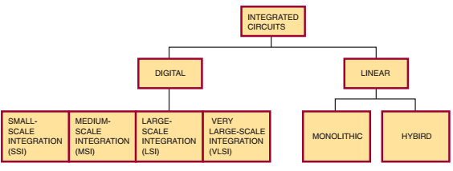
Families of Integrated Circuits
APPLICATION
CHIP SIZE
THIN IC
THICK IC
FABRICATION TECHNIQUES

Slide 13
CLASSIFICATION OF IC’S
On the basis of fabrication techniques used
On the basis of the chip size
On the basis of applications

Slide 14
ON BASIS OF FABRICATION
Monolithic IC’s
Thin and Thick Film IC’s.
Hybrid or Multi-chip ICs.

Slide 15
ON BASIS OF APPLICATIONS
LINEAR (Analog) INTEGRATED CIRCUITS
DIGITAL INTEGRATED CIRCUITS

Slide 16
ON BASIS OF CHIP SIZE
SSI (small-scale integration)
MSI (medium-scale integration)
LSI (large-scale integration)
VLSI (very large-scale integration)
ULSI (ultra large-scale integration)

Slide 17
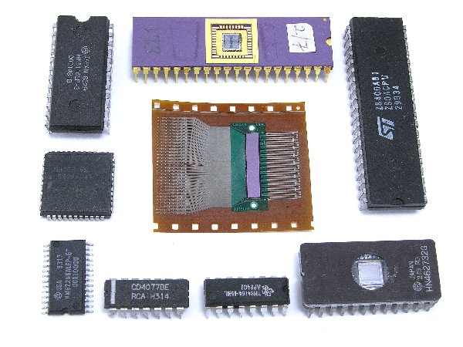
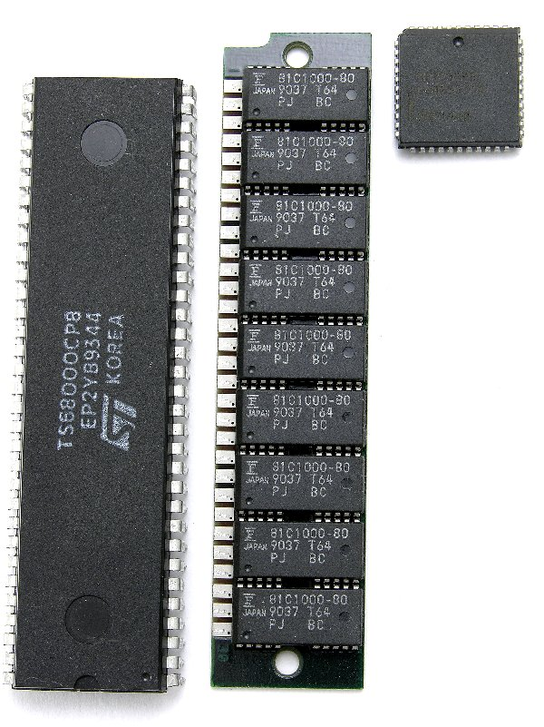
integrated circuits: | electrical components per chip | Years
Small-Scale Integration (SSI): | 3-100 | Early 1960s
Medium-Scale Integration (MSI): | 100 to 3,000 | late 1960s
Large-Scale integration (LSI): | 3,000 to 100,000 | mid 1970
ultra-large scale integration (VLSI ): | 100,000 to 1,000,000 | 1980s
SSI and MSI
LSI and VLSI

Slide 18
Integrated Circuit Packaging: what?
An integrated circuit is a thin chip consisting of hundreds to millions of interconnected semiconductor devices such as transistors, resistors, and capacitors.
In 2004, a typical chip size of 1 or
smaller was common, although larger sizes were also produced

Slide 19
Integrating Circuiting Packaging why?
Integrated circuits are mounted in packages designed to protect them from moisture, dust, and other contaminants.
The most popular package design is the dual-inline package (DIP)
IPs are manufactured in several sizes to accommodate the various sizes of integrated circuits:

Slide 20
Integrating Circuiting Packaging Design
Wafer - Scale Integration (WSI)
System on Chip Design (SOC)
Pin Grid Array package (PGA)
Leadless chip Carriers Packages (LCC)
Dual Inline Package (DIP)
Surface-mount packaging(SMP)
Plastic Quad Flat Package (PQFP) and
Thin Small Outline Package (TSOP) packaging.

Slide 21
Integrating Circuit Packaging
Wafer-scale integration (WSI): which uses uncut wafers containing entire computer systems including memory, was developed in the 1980s. It failed because of problems with creating a defect free manufacturing process.

Slide 22
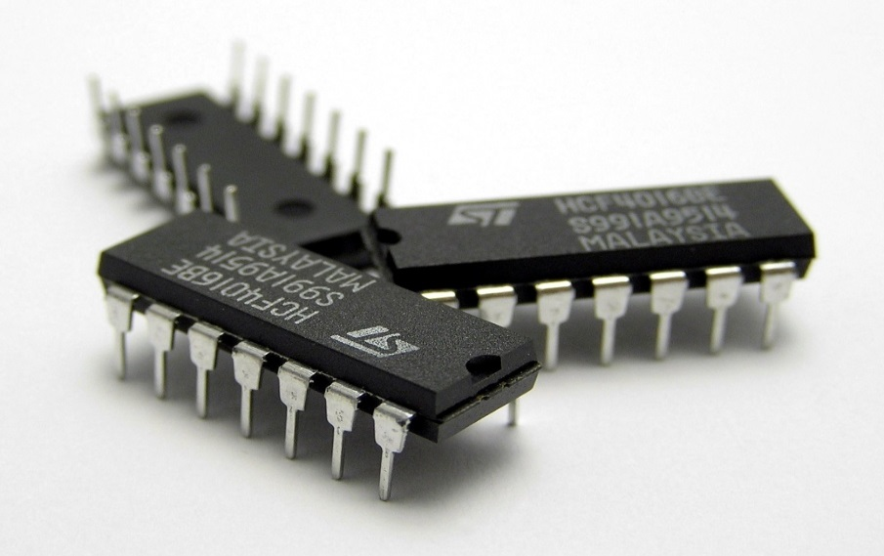
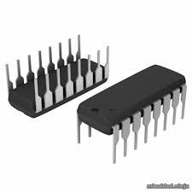
Dual In line Package (DIP)
Dual in-line package (DIP or DIL), or dual in-line pin package (DIPP)is an electronic component package with a rectangular housing and two parallel rows of electrical connecting pins.
Distance between pin rows: 7.62 mm (0.3"), 15.24 mm (0.6") or 22.86 mm (0.9")
Limited pins .

Slide 23
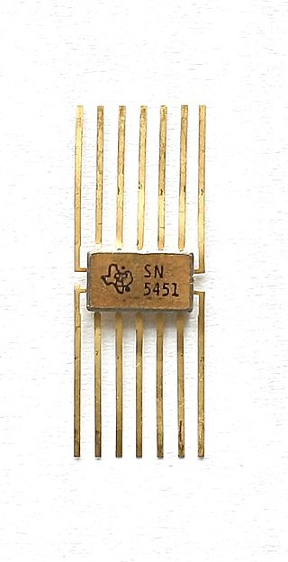
Contt….
A small 8-pin DIP, called a mini-DIP, is used for devices with a minimum number of inputs and outputs. It is used mostly with monolithic integrated circuits.
A flat-pack is smaller and thinner than a DIP and is used where space is limited. It is made from metal or ceramic and operates in a temperature range of - 55 to +125 degrees Celsius.

Slide 24
Advantage of DIP
Dual-in-line pick up (DIP) is the most popular IC package because
It is low in cost
It is one of the thiniest package known
It ruggedly resist vibration due to its solid construction

Slide 25
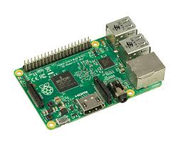
system-on-chip (SOC) and
WSI was followed by system-on-chip (SOC) design: is a single chip that integrates multiple functionalities that are typically needed for a system into the single chip itself. This could include one or more processor cores (single/dual/quad/octa cores), memory subsystems ,controllers , IO subsystems on single chip.
ADV: low cost ,large integration, mass production

Slide 26
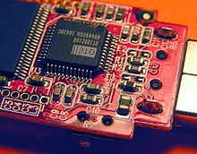
Surface Mount Packaging
Surface-mount packaging, which uses a fine lead pitch, became popular in the late 1980s.
Surface-mount technology (SMT) is a method for producing electronic circuits in which the components are mounted or placed directly onto the surface of printed circuit boards (PCBs). An electronic device so made is called a surface-mount device (SMD).

Slide 27
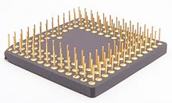
PIN Grid Array Package
A pin grid array, often abbreviated PGA, is a type of integrated circuit packaging. In a PGA, the package is square or rectangular, and the pins are arranged in a regular array on the underside of the package.
The pins are commonly spaced 2.54 mm (0.1") apart, and may or may not cover the entire underside of the package.

Slide 28
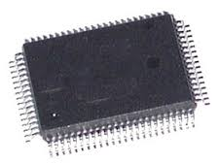
Plastic Quad Flat Package (PQFP)
In the late 1990s, high pin count devices used Plastic Quad Flat Package (PQFP) and Thin Small Outline Package (TSOP) packaging.
A QFP or Quad Flat Package is a surface mount integrated circuit package with "gull wing" leads extending from each of the four sides. Versions ranging from 32 to 304 pins with a pitch ranging from 0.4 to 1.0 mm(.03”) are common.

Slide 29
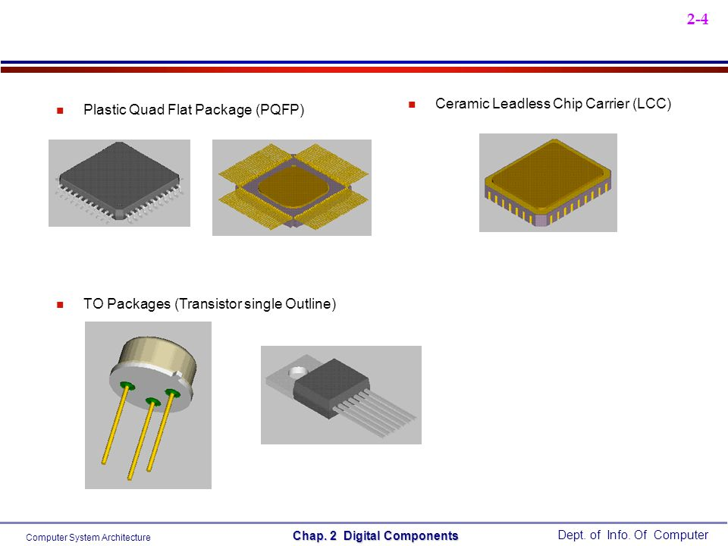
PQFP ,TO and LCC

Slide 30
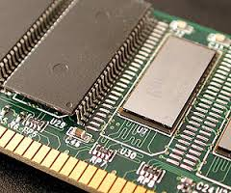
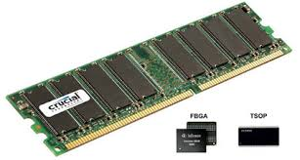
Thin small Outline Package
Thin Small Outline Package, or TSOP is a type of surface mount IC package. They are very low-profile (about 1mm(.03”)) and have tight lead spacing (as low as 0.5mm(.01”)). They are frequently used for RAM or Flash memory ICs due to their high pin count and small volume

Slide 31
system in package (SiP)
When it is not feasible to construct a SoC for a particular application, an alternative is a system in package (SiP) comprising a number of chips in a single package.
When produced in large volumes, SoC is more cost-effective than SiP because its packaging is simpler.

Slide 32
Material used for making IC Packaging
The package is made in either ceramic or plastic.
Plastic is less expensive and suitable for most applications where the operating temperature falls between 0 to 70 degrees Celsius.
Ceramic devices are more expensive but offer better protection against moisture and contamination. They also operate in a wider range of temperatures (- 55 to +125 degrees Celsius). Ceramic devices are recommended for military, aerospace, and severe industrial applications
Ceramic materials are inorganic, non-metallic materials made from compounds of a metal and a non metal. Ceramic materials may be crystalline or partly crystalline. They are formed by the action of heat and subsequent cooling. Example: silicon carbide, silicon nitride, glass, diamond, alumina etc

Slide 33
Families of Integrated Circuits

Slide 34
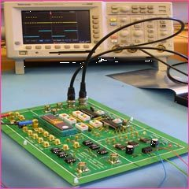
Introduction to Digital Family
Digital ICs operate at only a few defined levels or states, rather than over a continuous range of signal amplitudes. These devices are used in computers, computer networks, modems, and frequency counters. The fundamental building blocks of digital ICs are logic gates, which work with binary data, that is, signals that have only two different states, called low (logic 0) and high (logic 1).
Example 7408, 7486, 74266 etc

Slide 35
Digital Family
Small-Scale Integration (SSI): with up to 100 electrical components per chip (early 1960s)
Medium-Scale Integration (MSI): with 100 to 3,000 electrical components per chip (late 1960s)
Large-Scale integration (LSI): with 3,000 to 100,000 electrical components per chip (mid 1970)
Very Large-Scale Integration (VLSI): with 100,000 to 1,000,000 electrical components per chip (1980s).
Ultra Large-Scale Integration (ULSI)- More than 1 million electronic components per chip. The Intel 486 and Pentium microprocessors, for example, use ULSI technology. The line between VLSI and ULSI is vague

Slide 36
Linear or Analog IC
Linear ICs have continuously variable output that depends on the input signal level. As the term implies, the output signal level is a linear function of the input signal level. Ideally, when the instantaneous output is graphed against the instantaneous input, the plot appears as a straight line.
Linear ICs are used as audio-frequency (AF) and radio-frequency (RF) amplifiers. The operational amplifier(op amp) is a common device in these applications.
Example: 555 Timer IC, µA741 op-amp, LM78XX (Voltage Regulator) etc.

Slide 37
Linear IC
Monolithic IC
Hybrid IC

Slide 38
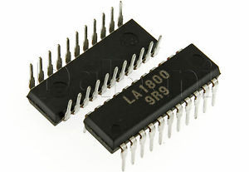
Monolithic IC
An integrated circuit or monolithic integrated circuit (also referred to as an IC, a chip, or a microchip) is a set of electronic circuits on one small plate ("chip") of semiconductor material, normally silicon

Slide 39
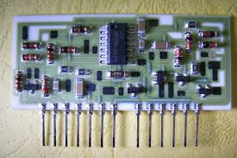
Hybrid IC
A Hybrid circuit consists of a (often ceramic) substrate carrying one or more silicon chips (which may themselves be monolithic integrated circuits, individual diodes, or transistors). Resistors and conductive tracks may be deposited on the substrate, and other parts may be soldered to the tracks to form a complete circuit. A hybrid can also use mixed technology, such as GaAs chips along with silicon chips.

Slide 40
Integrated Circuit Construction Techniques

Slide 41
Integrated Circuit Construction techniques
Integrated circuits are classified according to their construction techniques. The more common construction techniques are the following
Monolithic
Thin film
Thick film
Hybrid

Slide 42
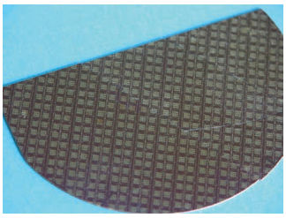
Construction of Monolithic IC
Monolithic integrated circuits are constructed in the same manner as transistors but include a few additional steps.
The integrated circuit begins with a circular silicon wafer 3 to 4 inches in diameter and about 0.010 inch thick. This serves as a substrate (base) on which the integrated circuits are formed. Many integrated circuits are formed at the same time on this wafer, up to several hundred, depending on the size of the wafer. The integrated circuits on the wafer are generally all the same size and type and contain the same number and type of components.

Slide 43
Construction of Monolithic IC
After fabrication
The integrated circuits are tested on the wafer.
After testing, the wafer is sliced into individual chips.
Each chip represents one complete integrated circuit containing all the components and connections associated with
that circuit.
Each chip that passes quality-control tests is then mounted into a package
YIELD: no of components passes the test /total no of components produced

Slide 44
Construction of Thin-film integrated circuits
Thin-film integrated circuits are formed on the surface of an insulating substrate of glass or ceramic, usually less than an inch square(< 1 inch). The components (resistors and capacitors) are formed by an extremely thin film of metal and oxides deposited on the substrate.
Thin strips of metal are then deposited to connect the components.
Diodes and transistors are formed as separate semiconductor devices and attached in the proper location.
Resistors are formed by depositing tantalum or nichrome on the surface of the substrate in a thin film 0.0001 inch thick. The value of the resistor is determined by the length, width, and thickness of each strip.
Conductors are formed of low-resistance metal such as gold, platinum, or aluminum. This process can produce a resistor accurate to within ± 0.1%. It can also obtain a ratio between resistors accurate to ± 0.01%. Accurate ratios are important for the proper operation of a particular circuit.
Two process to deposit components on the substrate-evaporation and sputtering

Slide 45
Construction of Thick-film integrated circuits
In thick-film construction, the resistors, capacitors, and conductors are formed on the substrate using a screen printing process:
A fine wire(SILK THREAD) screen is placed over the substrate and metalized ink is forced through the screen with a squeegee.
The screen acts as a mask. The substrate and ink are then heated to over 600 degrees Celsius to harden the ink.
Thick-film capacitors have low values (in picofarads). When a higher value is required, discrete capacitors are used. The thick-film components are
0.001 inch thick. The thick-film components resemble conventional discrete components.
http://www.ltcc.org.pl/about-ltcc/screen-printing/

Slide 46
Construction of Hybrid integrated circuits
Hybrid integrated circuits are formed using monolithic, thin-film, thick-film, and discrete components.
This allows for a high degree of circuit complexity by using monolithic circuits while at the same time taking advantage of extremely accurate component values and tolerances with the film techniques. Discrete components are used because
they can handle relatively large amounts of power

Slide 47
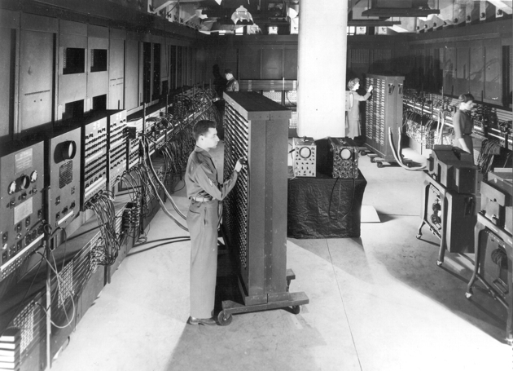
First computer by IBM
Notes:
ENIAC (Electronic Numerical Integrator and Computer)

Slide 48
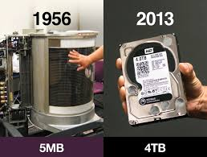
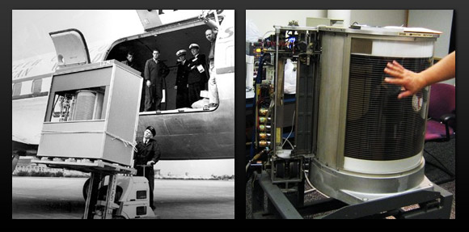
First Hard disk

